Slide 1
Talking about the Olympic games
Then and Now

Slide 2
Talking about the Olympic games
Then and Now

Slide 3
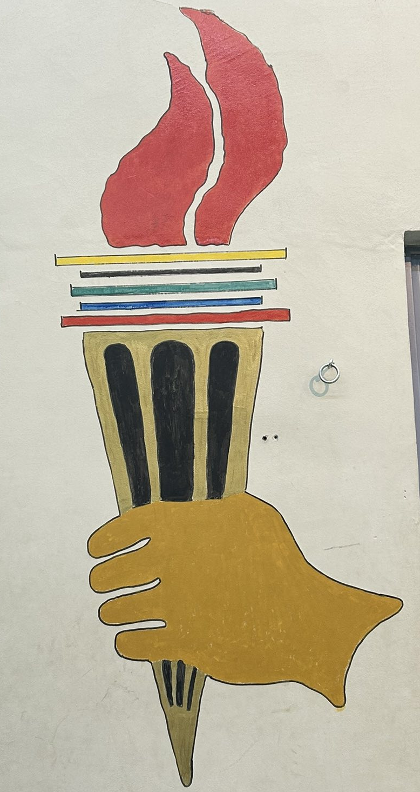
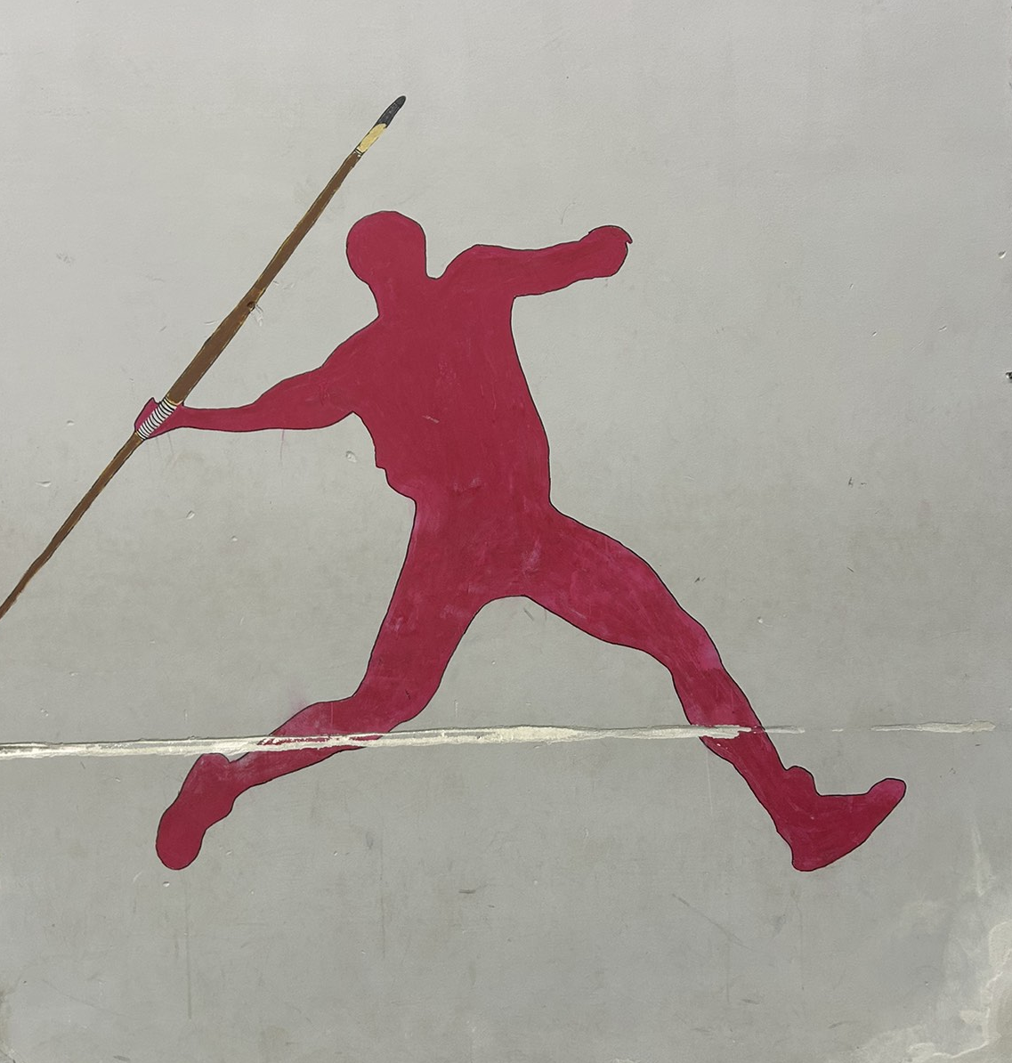
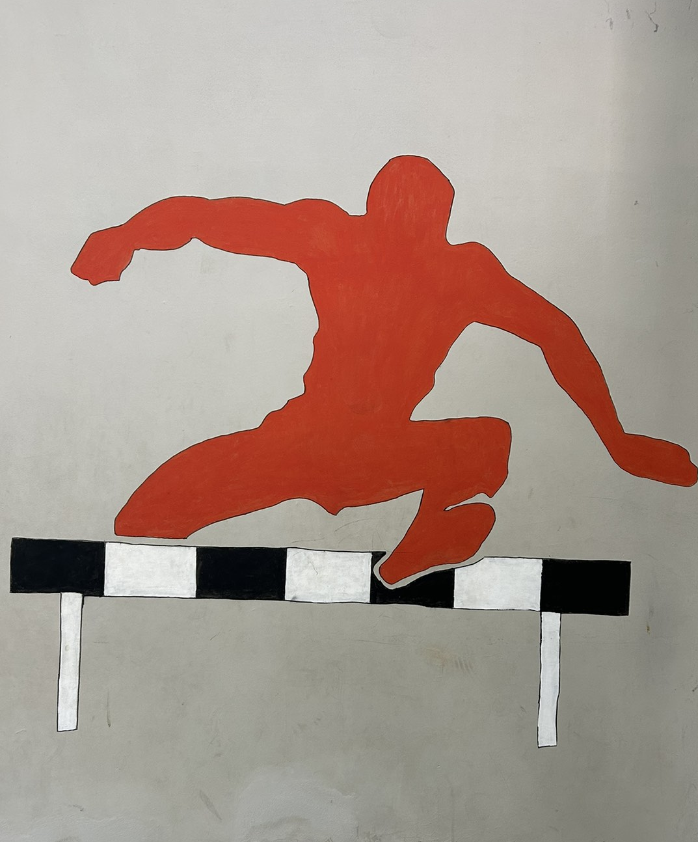
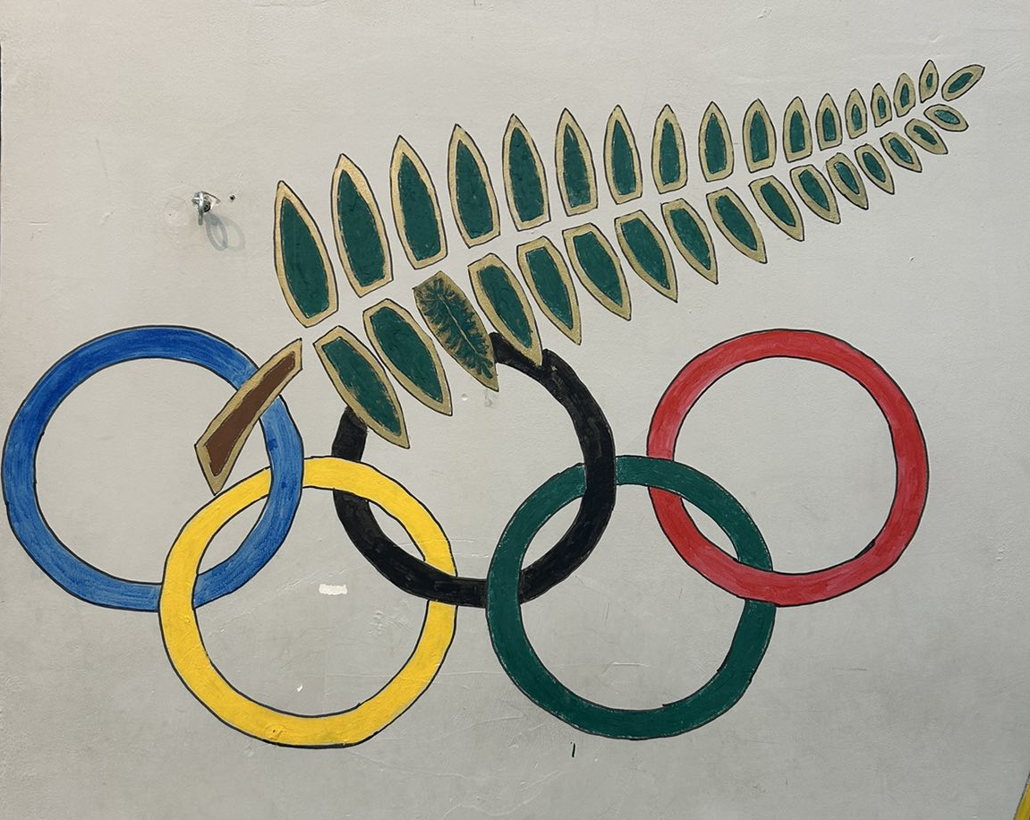

Slide 5
Introduction:
In honor of Zeus, the Ancient Olympic Games were first held in Olympia, Greece, in 776 BCE. They included chariot racing, wrestling, and running and were conducted every four years. The only males who could compete were free Greeks. Emperor Theodosius I prohibited the games in 393 CE, bringing them to an end.
Pierre de Coubertin brought the modern Olympic Games back to life in Athens, Greece, in 1896. 14 different nations sent athletes to compete in sports like gymnastics and athletics. The Olympics now feature both summer and winter competitions, bringing nations together via athletics.

Slide 6
Introduction:
In honor of Zeus, the Ancient Olympic Games were first held in Olympia, Greece, in 776 BCE. They included chariot racing, wrestling, and running and were conducted every four years. The only males who could compete were free Greeks. Emperor Theodosius I prohibited the games in 393 CE, bringing them to an end.
Pierre de Coubertin brought the modern Olympic Games back to life in Athens, Greece, in 1896. 14 different nations sent athletes to compete in sports like gymnastics and athletics. The Olympics now feature both summer and winter competitions, bringing nations together via athletics.

Slide 7
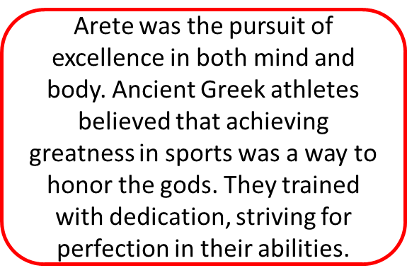
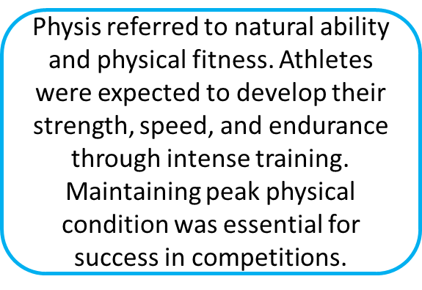
competitive
Competitiveness was a key part of the Olympic Games. Winning was the only goal, as there were no rewards for second place. Cheating was strictly punished, and victors were honored with prizes, fame, and sometimes statues in their home cities.
Arete
Physis

Slide 8
competitive
Competitiveness was a key part of the Olympic Games. Winning was the only goal, as there were no rewards for second place. Cheating was strictly punished, and victors were honored with prizes, fame, and sometimes statues in their home cities.
Arete
Physis

Slide 9
Values of Modern Olympic Games:
Sportsmanship
Sportsmanship is a core value of the modern Olympic Games. Athletes are expected to compete with fairness, respect, and integrity, regardless of winning or losing. The Olympics promote mutual respect among competitors and celebrate effort, discipline, and perseverance.
Inclusivity
Inclusivity ensures that athletes from all nations, backgrounds, and abilities can participate. The modern Olympics welcome both men and women, and events like the Paralympics highlight diversity in sports. This value promotes unity, equality, and the idea that sports can bring people together across cultures.

Slide 10
Values of Modern Olympic Games:
Sportsmanship
Sportsmanship is a core value of the modern Olympic Games. Athletes are expected to compete with fairness, respect, and integrity, regardless of winning or losing. The Olympics promote mutual respect among competitors and celebrate effort, discipline, and perseverance.
Inclusivity
Inclusivity ensures that athletes from all nations, backgrounds, and abilities can participate. The modern Olympics welcome both men and women, and events like the Paralympics highlight diversity in sports. This value promotes unity, equality, and the idea that sports can bring people together across cultures.

Slide 11
The impact the Olympic Games had on athletes:
Pride in Winning gives athletes a deep sense of accomplishment. Victory at the Olympics represents years of dedication, training, and sacrifice. Winning a medal is not just a personal achievement but also a moment of national pride, as athletes compete under their country’s flag.
Sense of Belonging is strong among Olympians. They feel connected to a global sports community and their national teams. Representing their country fosters unity and pride, creating lifelong bonds with fellow athletes.
Honor and Heroism come with Olympic success. Champions are celebrated as national heroes, inspiring future generations. Their achievements bring them admiration, respect, and a lasting legacy in the world of sports.

Slide 12
The impact the Olympic Games had on athletes:
Pride in Winning gives athletes a deep sense of accomplishment. Victory at the Olympics represents years of dedication, training, and sacrifice. Winning a medal is not just a personal achievement but also a moment of national pride, as athletes compete under their country’s flag.
Sense of Belonging is strong among Olympians. They feel connected to a global sports community and their national teams. Representing their country fosters unity and pride, creating lifelong bonds with fellow athletes.
Honor and Heroism come with Olympic success. Champions are celebrated as national heroes, inspiring future generations. Their achievements bring them admiration, respect, and a lasting legacy in the world of sports.

Slide 13
Modern Olympics
01
01
02
Emphasis
03
Emphasis on Role Models – Olympic athletes inspire young people to pursue excellence, discipline, and perseverance, shaping future generations in sports and beyond.
TEXT HERE
Role Models from a Young Age – Olympic athletes inspire youth to pursue sports, discipline, and excellence, encouraging active and healthy lives.
Awareness
Greater Awareness of Mental Health – There is a stronger focus on athletes' well-being, with many Olympians speaking openly about mental health, reducing stigma, and promoting support.

Slide 14
Modern Olympics
01
01
02
03
Emphasis
Inspiration
Awareness
Emphasis on Role Models – Olympic athletes inspire young people to pursue excellence, discipline, and perseverance, shaping future generations in sports and beyond.
Role Models from a Young Age – Olympic athletes inspire youth to pursue sports, discipline, and excellence, encouraging active and healthy lives.
Greater Awareness of Mental Health – There is a stronger focus on athletes' well-being, with many Olympians speaking openly about mental health, reducing stigma, and promoting support.

Slide 15
Conclusion:
The Olympic Games continue to be a symbol of excellence, unity, and perseverance. From ancient times to the modern era, they have inspired athletes to push their limits and uphold values like sportsmanship, inclusivity, and mental resilience. Beyond competition, the Olympics bring nations together, celebrate human potential, and leave a lasting legacy of inspiration for future generations.

Slide 16
Conclusion:
The Olympic Games continue to be a symbol of excellence, unity, and perseverance. From ancient times to the modern era, they have inspired athletes to push their limits and uphold values like sportsmanship, inclusivity, and mental resilience. Beyond competition, the Olympics bring nations together, celebrate human potential, and leave a lasting legacy of inspiration for future generations.

Slide 17
Links and websides:
https://en.wikipedia.org/wiki/Ancient_Olympic_Games?utm_source=chatgpt.com
https://www.olympics.com/en/news/the-history-of-the-olympic-games?utm_source=chatgpt.com
https://www.thetimes.co.uk/article/olympians-scale-sports-peaks-life-mental-health-763dw9sbz?utm_source=chatgpt.com
The artwork and musical pieces showcased on slide two are all original creations by Olympiad participants.

Slide 18
Aradippou Secondary School Students names:Christina Livitzi A3Anastasis Koushappas C8Mikaella Christoforou C8Agathaggelos GeorgiouvC9 Nektarios Christoforou C7Aradippou Secondary School Teachers' names:Irene Theophilidou English teacher Assistant Physical Education Principal: Mrs Angelika MeliPhysical Education Teacher: Ms. Nicolena Efthimiou Σε ευχαριστώ πολύ για το τέλειωμα του PowerPoint presentation.

